Slide 1
Instructions for use (free users)
In order to use this template, you must credit Slidesgo by keeping the Thanks slide.
You are allowed to:
Modify this template.
Use it for both personal and commercial purposes.
You are not allowed to:
Sublicense, sell or rent any of Slidesgo Content (or a modified version of Slidesgo Content).
Distribute this Slidesgo Template (or a modified version of this Slidesgo Template) or include it in a database or in any other product or service that offers downloadable images, icons or presentations that may be subject to distribution or resale.
Use any of the elements that are part of this Slidesgo Template in an isolated and separated way from this Template.
Delete the “Thanks” or “Credits” slide.
Register any of the elements that are part of this template as a trademark or logo, or register it as a work in an intellectual property registry or similar.
For more information about editing slides, please read our FAQs or visit Slidesgo School:
https://slidesgo.com/faqs and https://slidesgo.com/slidesgo-school

Slide 2
Instructions for use (premium users)
In order to use this template, you must be a Premium user on Slidesgo.
You are allowed to:
Modify this template.
Use it for both personal and commercial purposes.
Hide or delete the “Thanks” slide and the mention to Slidesgo in the credits.
Share this template in an editable format with people who are not part of your team.
You are not allowed to:
Sublicense, sell or rent this Slidesgo Template (or a modified version of this Slidesgo Template).
Distribute this Slidesgo Template (or a modified version of this Slidesgo Template) or include it in a database or in any other product or service that offers downloadable images, icons or presentations that may be subject to distribution or resale.
Use any of the elements that are part of this Slidesgo Template in an isolated and separated way from this Template.
Register any of the elements that are part of this template as a trademark or logo, or register it as a work in an intellectual property registry or similar.
For more information about editing slides, please read our FAQs or visit Slidesgo School:
https://slidesgo.com/faqs and https://slidesgo.com/slidesgo-school

Slide 3
Map of Saudi Arabia Infographics
Saudi Arabia
Officially the Kingdom of Saudi Arabia, it’s a country in Western Asia
Capital
Riyadh
Currency
Saudi Riyal (SR)
Population
34 Million

Slide 4
Map of Saudi Arabia Infographics
Riyadh
Venus has a beautiful name and is the second one from the Sun
Persian Gulf
Mercury is the closest planet to the Sun and the smallest one
Red Sea
Despite being red, Mars is a cold place full of iron oxide dust
Gulf of Aden
It’s a gas giant and the biggest planet in the Solar System

Slide 5
Map of Saudi Arabia Infographics
Hail
Venus has a beautiful name and is the second planet from the Sun
Madinah
Mercury is the closest to the Sun and the smallest one in the System
Makkah
Despite being red, Mars is a cold place full of iron oxide dust
Asir
Jupiter is a gas giant and the biggest planet in the Solar System

Slide 6
Map of Saudi Arabia Infographics
Ar’ar
Madinah
Jizan
Riyadh
Neptune is the farthest planet
Despite being red Mars is cold
Venus has a beautiful name
Mercury is very close to the Sun

Slide 7
Map of Saudi Arabia Infographics
45%
87%
Mercury
Saturn
Mercury is the closest planet to the Sun and the smallest one
It is the ringed planet. It is composed of hydrogen and helium
24%
48%
Jupiter
Mars
Jupiter is a gas giant and the biggest object in the Solar System
Despite being red, Mars is actually a very cold place

Slide 8
Map of Saudi Arabia Infographics
50%
25%
75%
Makkah
Madinah
Riyadh
Mercury is the smallest planet of them all
Saturn is a gas giant and has several rings
Jupiter is the biggest planet of them all

Slide 9
Map of Saudi Arabia Infographics
Makkah
Or Mecca, in a desert valley in western Saudi Arabia, is Islam’s holiest city, as it’s the birthplace of the Prophet Muhammad
Area
1,200 km²
Population
33 million (2020)

Slide 10
Map of Saudi Arabia Infographics
Kingdom Tower
Al Faisaliyah
It’s the closest to the Sun and the smallest one. It was named after a Roman deity
Jupiter is the biggest object in the Solar System and also an orange gas giant
Islamic Bank
Center Point
Venus has a really beautiful name and is the second planet from the Sun
Despite being red, Mars is actually a cold place and is full of iron oxide dust

Slide 11
Map of Saudi Arabia Infographics
Mercury is the closest planet to the Sun and the smallest
78%
Despite being red, Mars is actually a very cold place
39%
Venus has a beautiful name, but it’s terribly hot
57%
Neptune is the farthest planet from the Sun
46%

Slide 12
Map of Saudi Arabia Infographics
90%
Arabs
Ethnic Groups in Saudi Arabia
Mercury is the closest planet to the Sun and the smallest one
Venus has a really beautiful name and is the second planet from the Sun
10%
Afro-Asian
It is the ringed planet. It is composed of hydrogen and helium

Slide 13
Map of Saudi Arabia Infographics
4500
2500
It is a gas giant and the biggest planet
Despite being red, it is a very cold place
1000
500
It is the farthest planet from the Sun
It is hot and has a beautiful name
Saudi Arabia estimated population density. Data shown as people per km2

Slide 14
Map of Saudi Arabia Infographics
Hajj
Kaaba
Annual Islamic pilgrimage to Mecca, the holiest muslim city
It is the most sacred site in Islam, considered to be the 'House of God'
Farīḍah
Hasanat
In Islam it’s a religious duty commanded by God to receive hasanat
Credit for good deeds, which Allah weighs up against one's bad deeds

Slide 15
Map of Saudi Arabia Infographics
95%
80%
Makkah
Madinah
Venus has a beautiful name and is the second planet from the Sun
Saturn is composed mostly of hydrogen and also helium
50%
75%
Najran
Al Qassim
Jupiter is a gas giant and the biggest planet in the entire Solar System
Despite being red, Mars is actually a cold place full of iron oxide dust

Slide 16
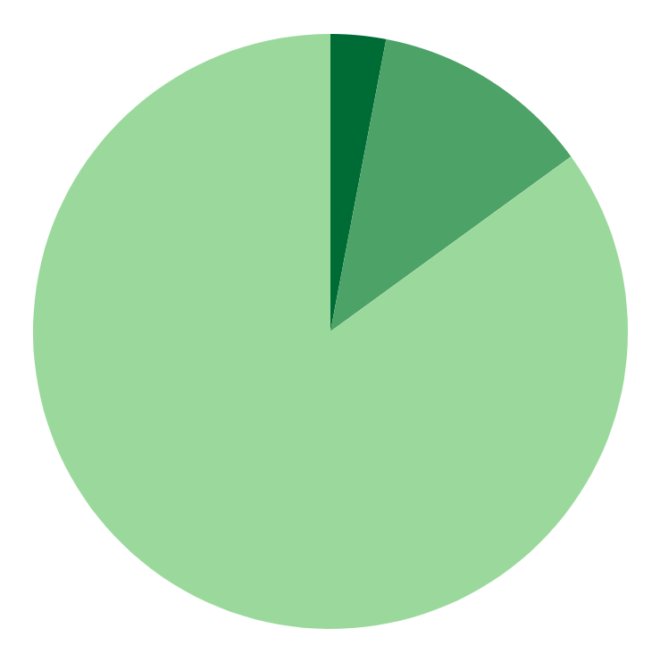
Map of Saudi Arabia Infographics
Sunni
85%
Venus has a beautiful name, but it’s really hot
Shia
12%
Despite being red, Mars is a very cold place
Other
3%
It’s the smallest planet in the Solar System

Slide 17
Map of Saudi Arabia Infographics
Jobs
40%
30%
Jupiter
Mars
20%
10%
Neptune
Saturn
Gender
80%
20%
Jupiter is the biggest planet of them all

Slide 18
Map of Saudi Arabia Infographics
Min. 23 °C - Max. 29 °C
Min. 24 °C - Max. 32 °C
Despite being red, Mars is a cold place full of iron oxide dust
Venus has a beautiful name and is the second planet from the Sun
Min. 27 °C - Max. 31 °C
Min. 20 °C - Max. 29 °C
Mercury is the closest planet to the Sun and the smallest of them all
Jupiter is a gas giant and the biggest planet in the Solar System

Slide 19
Map of Saudi Arabia Infographics
01
02
03
04
Hail
Madinah
Makkah
Asir
Venus is the second planet from the Sun
Saturn is composed of hydrogen and helium
It’s the smallest planet in the Solar System
Mars is actually full of iron oxide dust

Slide 20
Map of Saudi Arabia Infographics
53%
Male population
Female population
Mercury is the closest planet to the Sun and
the smallest one in the entire Solar System
Saturn is a gas giant and has several rings. It is composed mostly of hydrogen and helium
47%

Slide 21
Map of Saudi Arabia Infographics
Kaaba
Despite being red, Mars is very cold
Abraj Al Bait
Neptune is the farthest planet from the Sun
Masjid al-Haram
Venus has a beautiful name, but it’s hot

Slide 22
Map of Saudi Arabia Infographics
30%
Despite being red, Mars is actually a cold place
10%
Jupiter is the fourth-brightest object
20%
Mercury is the closest planet to the Sun
40%
Venus is the second planet from the Sun

Slide 23
Map of Saudi Arabia Infographics
A
45%
B
55%

Slide 24
Map of Saudi Arabia Infographics
Mars
Despite being red, Mars is a very cold place
Venus
Venus has a beautiful name, but it’s really hot
Mercury
It’s the smallest planet in the Solar System

Slide 25
Map of Saudi Arabia Infographics
Mesophytes
Xerophytes
Venus is the second planet from the Sun
Mercury is the closest planet to the Sun
Hydrophytes
Heliophytes
Jupiter is the biggest planet of them all
Mars is a cold place full of iron oxide dust

Slide 26
Map of Saudi Arabia Infographics
Unemployment Rate in Saudi Arabia
30%
75%
70%
80%

Slide 27
Map of Saudi Arabia Infographics
Köppen-Geiger climate classification
Arid, desert, hot
Arid, desert, cold
It is a gas giant and the biggest planet
It is hot and has a beautiful name
Arid, steppe, hot
Arid, steppe, cold
It is the farthest planet from the Sun
Despite being red, it is a very cold place

Slide 28
Map of Saudi Arabia Infographics
Amala
Riyadh
It is a gas giant and the biggest planet
Despite being red, it is a very cold place
Mecca
Jubail
It is the farthest planet from the Sun
It is hot, but has a beautiful name
Commercial Airport
Military Airport

Slide 29
Map of Saudi Arabia Infographics
85%
15%
Arabic
English
It’s the biggest planet of them all
It’s the planet where we live on

Slide 30
Map of Saudi Arabia Infographics
20%
40%
30%
60%
30%
Makkah
Madinah
Riyadh
Najran
Al Qassim
Mercury is the smallest planet
Venus is the second planet
Jupiter is the biggest planet
Saturn is a ringed planet
Mars is a very cold place

Slide 31
Map of Saudi Arabia Infographics
1
Madinah
Saudi Arabia
It’s the biggest planet in the Solar System
2
Makkah
Despite being red, Mars is a cold place
3
Riyadh
Venus is the second planet from the Sun

Slide 32
Map of Saudi Arabia Infographics
Per capita income (PCI)
Venus has a beautiful name, but is a hot place
800
700
600
500
400
300
200
100
Makkah
Madinah
Riyadh
Najran

Slide 33
Instructions for use
In order to use this template, you must credit Slidesgo and Freepik in your final presentation and include links to both websites.
You are allowed to:
- Modify this template.
- Use it for both personal and commercial projects.
You are not allowed to:
- Sublicense, sell or rent any of Slidesgo Content (or a modified version of Slidesgo Content).
- Distribute Slidesgo Content unless it has been expressly authorized by Slidesgo.
- Include Slidesgo Content in an online or offline database or file.
- Offer Slidesgo templates (or modified versions of Slidesgo templates) for download.
- Acquire the copyright of Slidesgo Content.
For more information about editing slides, please read our FAQs or visit Slidesgo School:
https://slidesgo.com/faqs and https://slidesgo.com/slidesgo-school

Slide 34
Infographics
You can add and edit some infographics to your presentation to present your data in a visual way.
Choose your favourite infographic and insert it in your presentation using Ctrl C + Ctrl V or Cmd C + Cmd V in Mac.
Select one of the parts and ungroup it by right-clicking and choosing “Ungroup”.
Change the color by clicking on the paint bucket.
Then resize the element by clicking and dragging one of the square-shaped points of its bounding box (the cursor should look like a double-headed arrow). Remember to hold Shift while dragging to keep the proportions.
Group the elements again by selecting them, right-clicking and choosing “Group”.
Repeat the steps above with the other parts and when you’re done editing, copy the end result and paste it into your presentation.
Remember to choose the “Keep source formatting” option so that it keeps the design. For more info, please visit Slidesgo School.

